Slide 1
HCI Group 5
Niran
Hi-Fidelity Prototype
Team Members:
Arshad Abbas(2019300)
Arihant Singh(2019298)
Khushi Agarwal(2019312)
Kirti Gautam(2018291)
Sudeep Reddy(2019313)

Slide 2
Solution Statement:
Problem Statement:
Our vast history and local traditions are getting lost in today’s fast and urbanised lifestyles.
A youngster has little knowledge of the vast history and local traditions of their country as they have no time and interest, this makes them feel uniformed and at loss.
An elderly person has no way to tell the stories they know and have heard about their surrounding through their lives and this makes them feel frustrated and angry.
Niran will help bridge the gap between the glories of our past and the younger generation’s interest. We have made use of gamification to let people tell the stories they know and let others learn about these. Our aim is to make historical stories, legends and local traditions easily accessible, interactive and bring them to life.

Slide 3
Task Sequence To create and add a Checkpoint
Step 1 : Users are welcomed by the homepage. User picks the option to create a storywalk.
Step 2 : The user is given the option to choose between the current location they are at or another location to add the storywalk to . The user chooses the current location option.
Step 3 : They are asked to add the description of the checkpoint and the time period that they are creating the story walk from. The user adds the description and the time period and clicks next.
Step 4 : They are given the option to add an avatar or an element to the scene. They can do both. The user picks add an avatar.
Step 5 : While adding an avatar to the scene they are able to choose from an avatar library or create their own avatar and are asked to add a description and dialogs for the avatar. After choosing and adding these the user clicks next.
Continued...

Slide 4
Step 6 : While adding an element to the screen the user is able to choose from an element library from which they can select the various elements they want to add to the scene. The user selects a few elements and clicks next.
Step 7 : The user is then taken to his camera from which he is able to add elements onto the space in real time while being able to edit aspects of the elements. The user places all the elements that they picked into the scene via the camera with the proper orientation. The user clicks done.
Step 8 : The user is asked to add a path the viewer's need to follow to complete the storywalk that the user has created. The user adds a path on the map and clicks next.
Step 9 : The user is presented with a screen which tells them that their checkpoint has been added and they are asked whether they want to create another checkpoint or finish their storywalk.

Slide 5
Link to Clickable Prototype
Niran Hi-fi Prototype

Slide 6
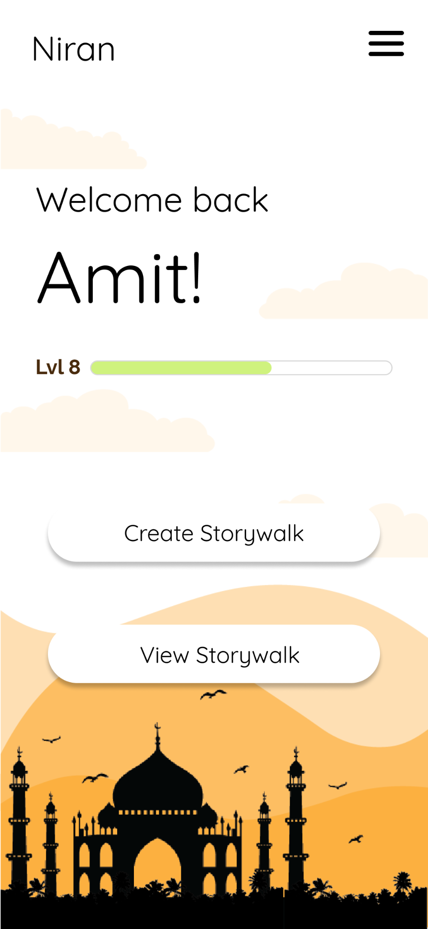
Click Create Storywalk

Slide 7
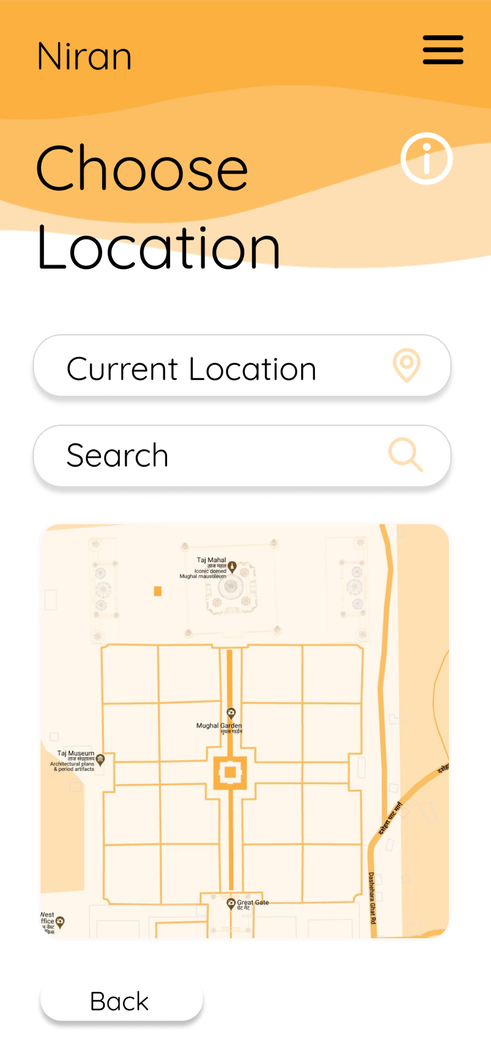
Click Current Location.

Slide 8
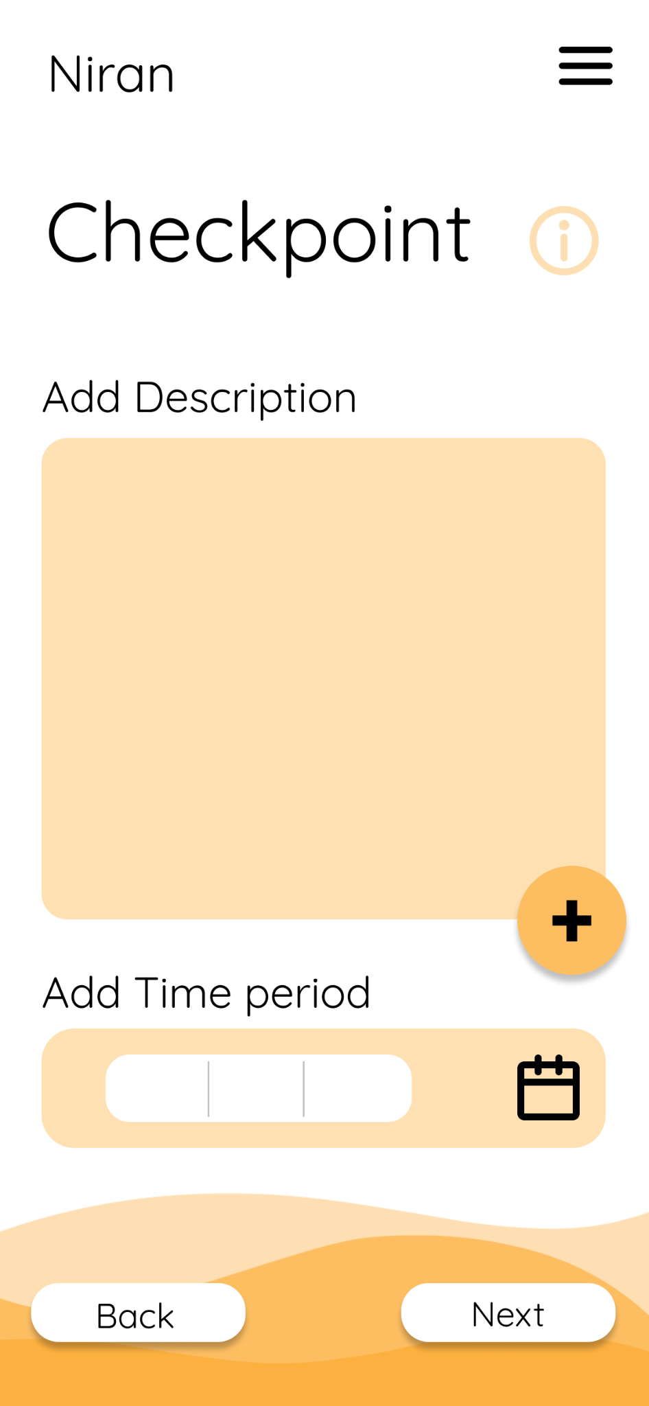
Add text to Add Description.
Click plus button.
Select time period by either typing it or clicking the calendar button.
Click Next

Slide 9
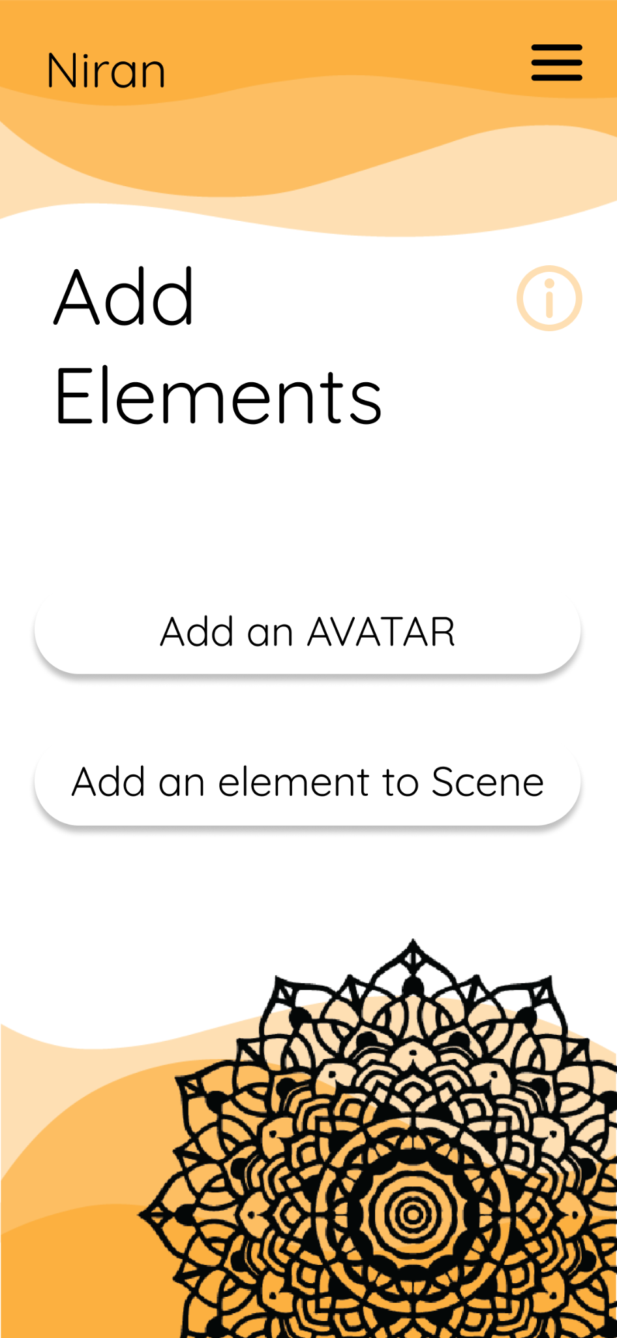
Click Add an AVATAR or Add an element to Scene.

Slide 10
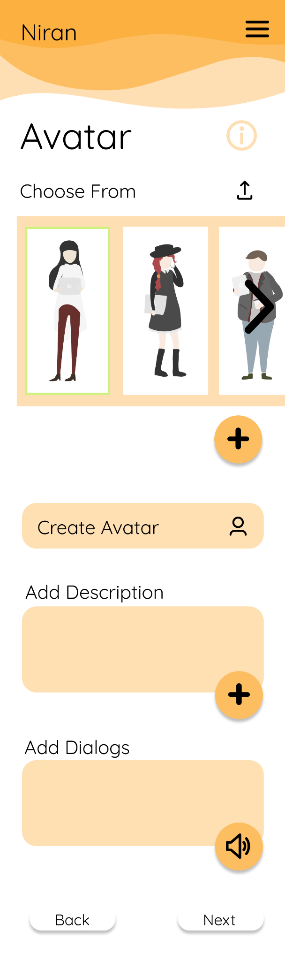
Choose an avatar by clicking on the image.
Click plus button.
Click Create Avatar.
Add text to Add Description.
Click plus button.
Add dialogs by either typing them or clicking the speaker button to add it as a voice message.
Click Next

Slide 11
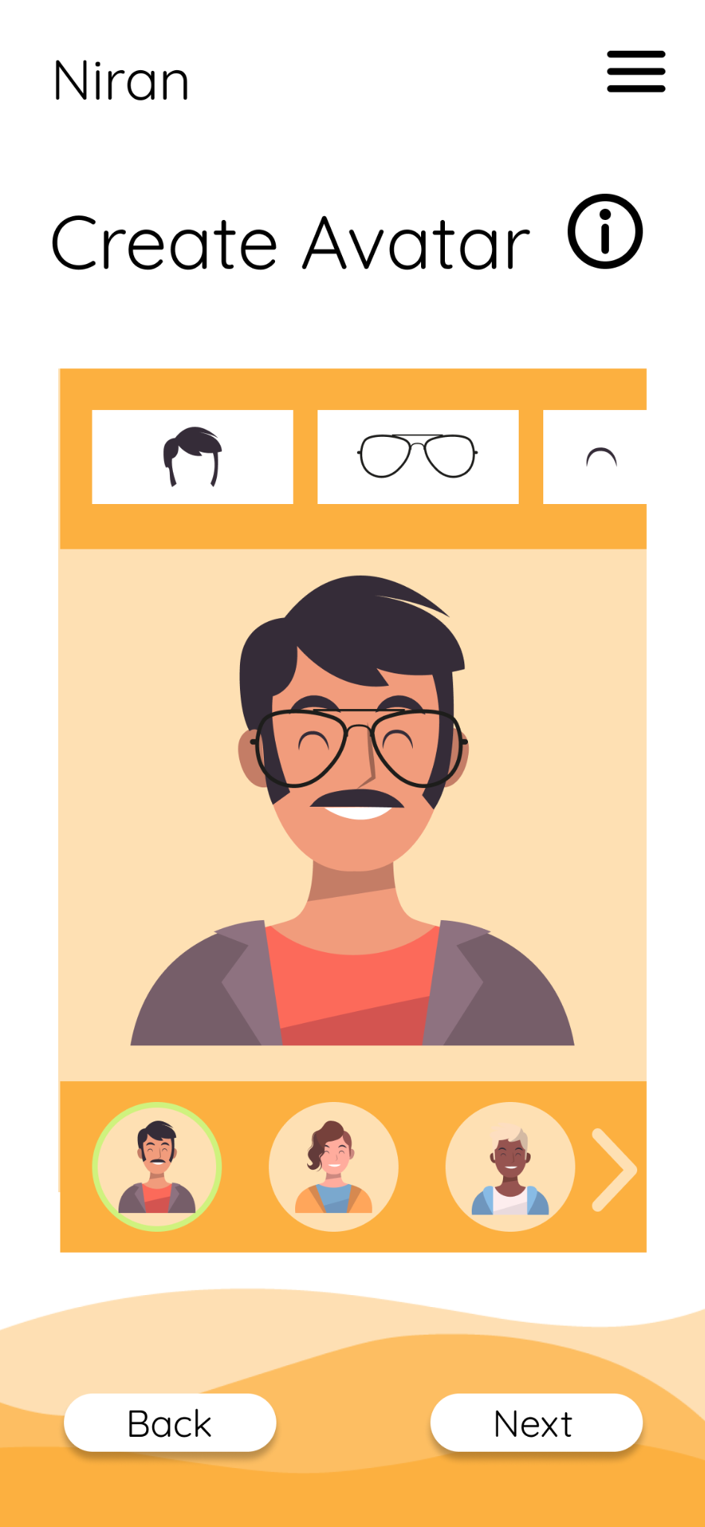
Click on the various available presets for the avatars.
Customise their looks and appearances.
Click Next.

Slide 12
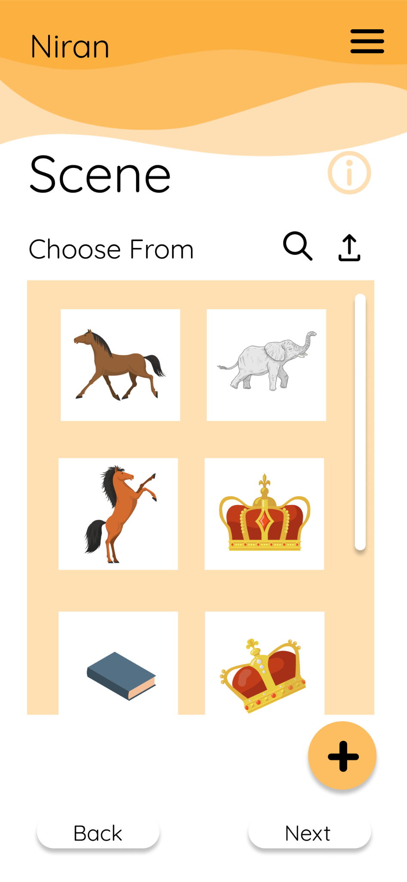
Click the Search button to search for elements you would like to add.
You could also upload elements and then select them.
Then click the plus to add all the elements to the scene.
Then click Next.

Slide 13
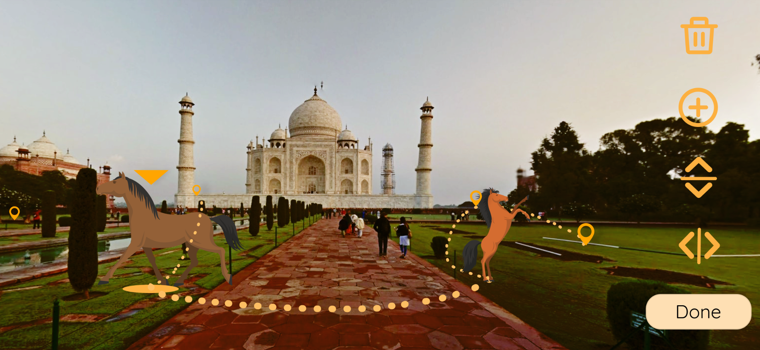
Add elements and avatars selected previously.
Click Next to connect these elements with a path.

Slide 14
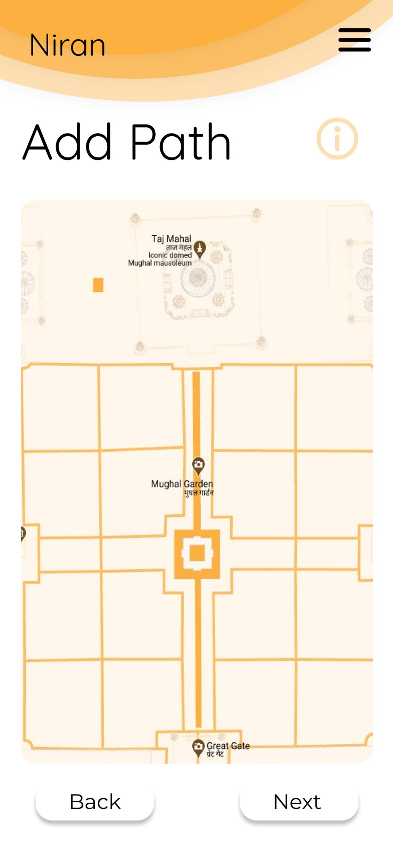
Draw a path on the map for people to view your Storywalk.
Click Next to complete storywalk.

Slide 15
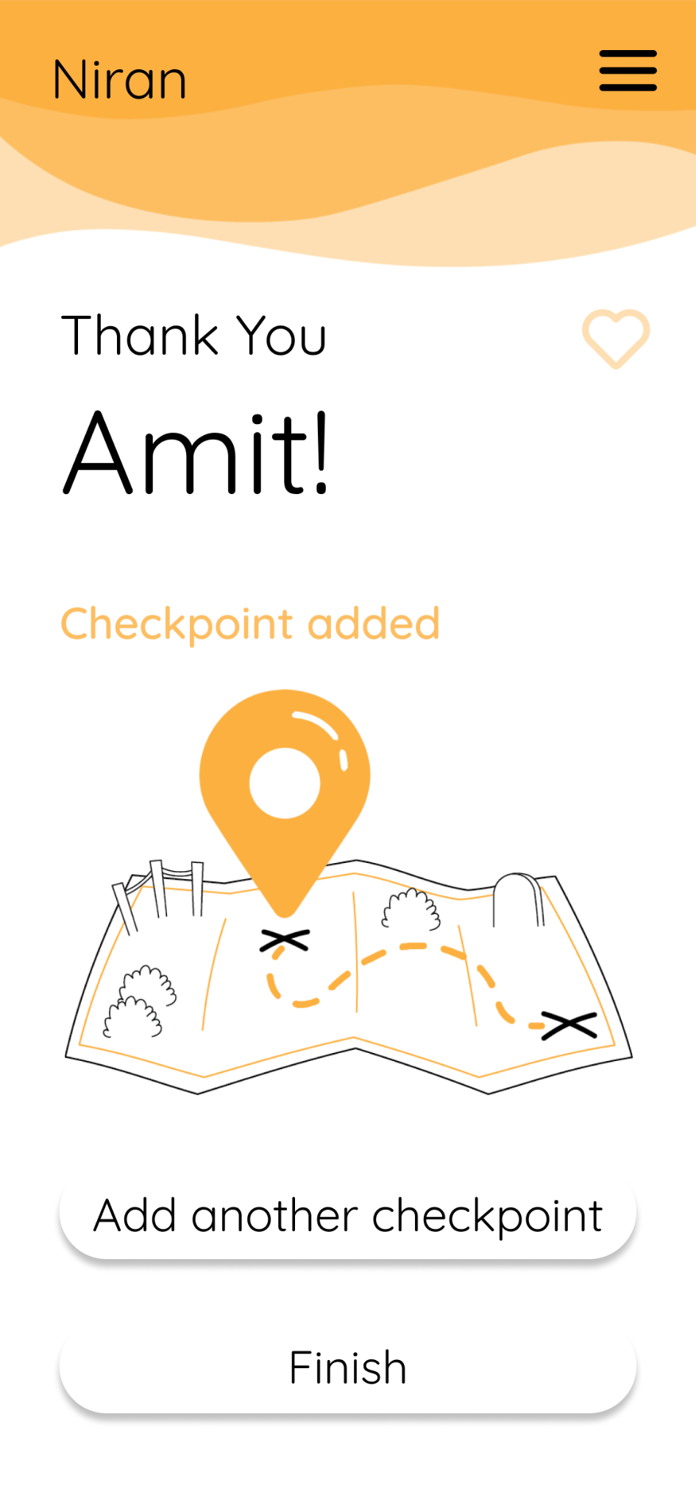
Click Finish button.

Slide 16
Thank you

